Slide 1

Web Application
MONSOON.CO.UK
FINAL PROJECT

Slide 2

APPLICATION DESCRIPTION
MONSOON
WEB APPLICATION
Online fashion retail company
Delivery in over 180 countries

Slide 3

TESTING APPROCH
Exploratory testing for the main functionality.
Select the test environment
Bugs written down so they can be replicated.
Write the smoke test and execute them.
Select the test environment.
Component testing, Integration, System, System Integration
Write the Test Report.

Slide 4

TOOLS USED
Xmind Tool- Mind Maps
Snipping Tool- Screenshots Capture
Mantis Bug Tracker- Bugs Reporting

Slide 5

TESTING TYPES
Functional testing
Exploratory testing
Smoke testing
Negative testing
Pozitive testing
UI testing
Compatibility testing

Slide 6
Bugs overview
Functionality | Nr of bugs | Severity
My account | 2 | normal
Search | 1 | minor
User interface | 2 | minor

Slide 7
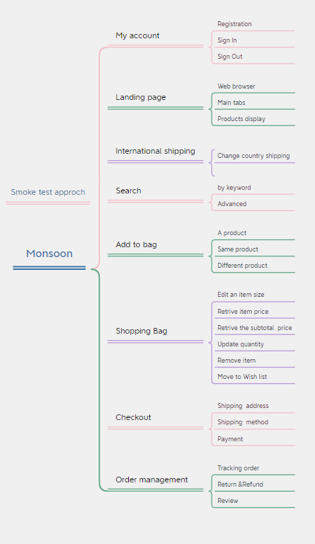
TEST CASES OVERVIEW

Slide 8
TEST CASES RESULTS
Functionality | Total | Pass | Failed | Blocked | Not run | Defects
My account | 4 | 4 | 0 | 0 | 0 | 0
Landing page | 3 | 3 | 0 | 0 | 0 | 0
International shipping | 1 | 1 | 0 | 0 | 0 | 0
Search | 2 | 2 | 0 | 0 | 0 | 0
Add to bag | 3 | 3 | 0 | 0 | 0 | 0
Shopping bag | 6 | 6 | 0 | 0 | 0 | 0
Checkout | 4 | 4 | 0 | 0 | 0 | 0
Order management | 3 | 3 | 0 | 0 | 0 | 0

Slide 9
CONCLUSIONS
26 test cases were executed to test the happy flow, all of them pass and no bugs were found during the smoke test.
In the Exploratory testing 5 bugs were identified 2 of them with normal severity and 3 with minor severity.
Data type used during testing was: Valid, Invalid, Blank, Big data
Is recommended to fix all the bugs.

Slide 10

LESSONS LEARNED
Smoke testing helps to see if the application works
Exploratory testing facilities learning functionality
Use simple steps for writing the test cases and for bug reporting.

Slide 11

Thank you!!!
FEEDBACK

